Slide 1
Data Structures
and
Algorithms
Merge Sort
Quick Sort
CSCI 237 –
Fall 2019

Slide 2
Sorting Algorithms
Sorting problem: The sorting problem is to rearrange the items of a given list in non-decreasing order.
We look for: (i) Complexity
(ii) Is it stable
(iii) Is it in-place?
Sort input
5 | 3 | 1 | 9 | 8 | 2 | 4 | 7

Slide 3
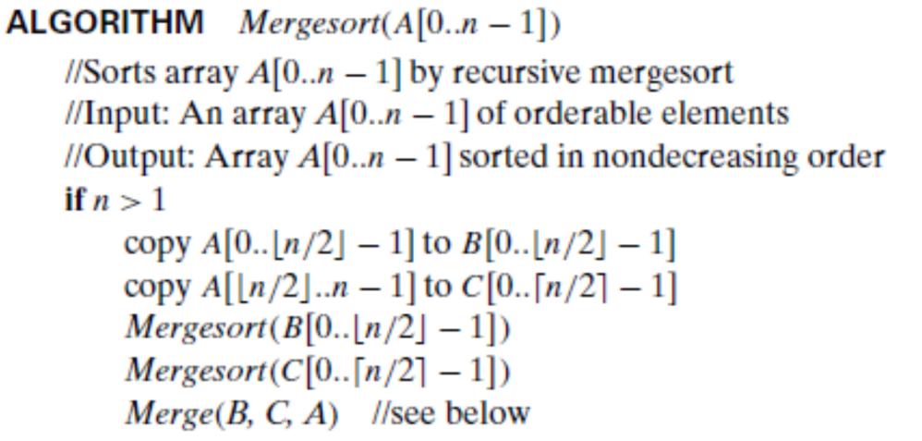
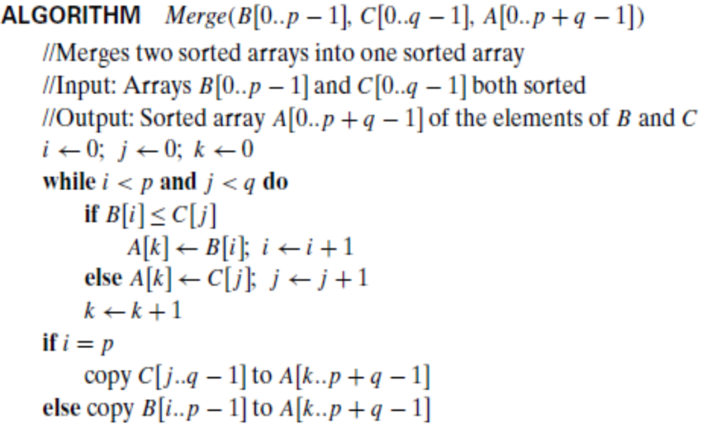
Sorting Algorithms
MergeSort:
Q. How does the division happen here?
Q. How does combining happen here?
Q. Where does bulk of the work happen?
Q. Complexity?

Slide 4
Sorting Algorithms
QuickSort:
The effort in QuickSort is to create the partitions – left and right, around the split.
Decision: How to select the split point?
Once we decide on how to select the split, we can apply it to the partitions defining the left and the right sub-arrays.
ALGORITHM Quicksort(A[l..r]) //Sub-array A[l..r] defines the split
//Sorts a subarray by quicksort
//Input: Subarray of array A[0..n − 1], defined by its left and right indices l and r
//Output: Subarray A[l..r] sorted in nondecreasing order
if l < r
s ←Partition(A[l..r]) //s is a split position
Quicksort(A[l..s − 1])
Quicksort(A[s + 1..r])

Slide 5
Sorting Algorithms
Suppose we the first element, in index position ‘0’ of the Array A as the split element (pivot).
We will now scan the subarray from both ends, comparing the subarray’s elements to the pivot.
The left-to-right scan, denoted by index pointer i, starts with the second element.
We want elements smaller than the pivot to be in the left part of the subarray.
Therefore, this scan skips over elements that are smaller than the pivot and stops upon encountering the first element greater than or equal to the pivot.
The right-to-left scan, denoted by index pointer j, starts with the last element of the subarray.
We want elements larger than the pivot to be in the right part of the subarray.
Therefore, this scan skips over elements that are larger than the pivot and stops upon encountering the first element smaller than or equal to the pivot.

Slide 6
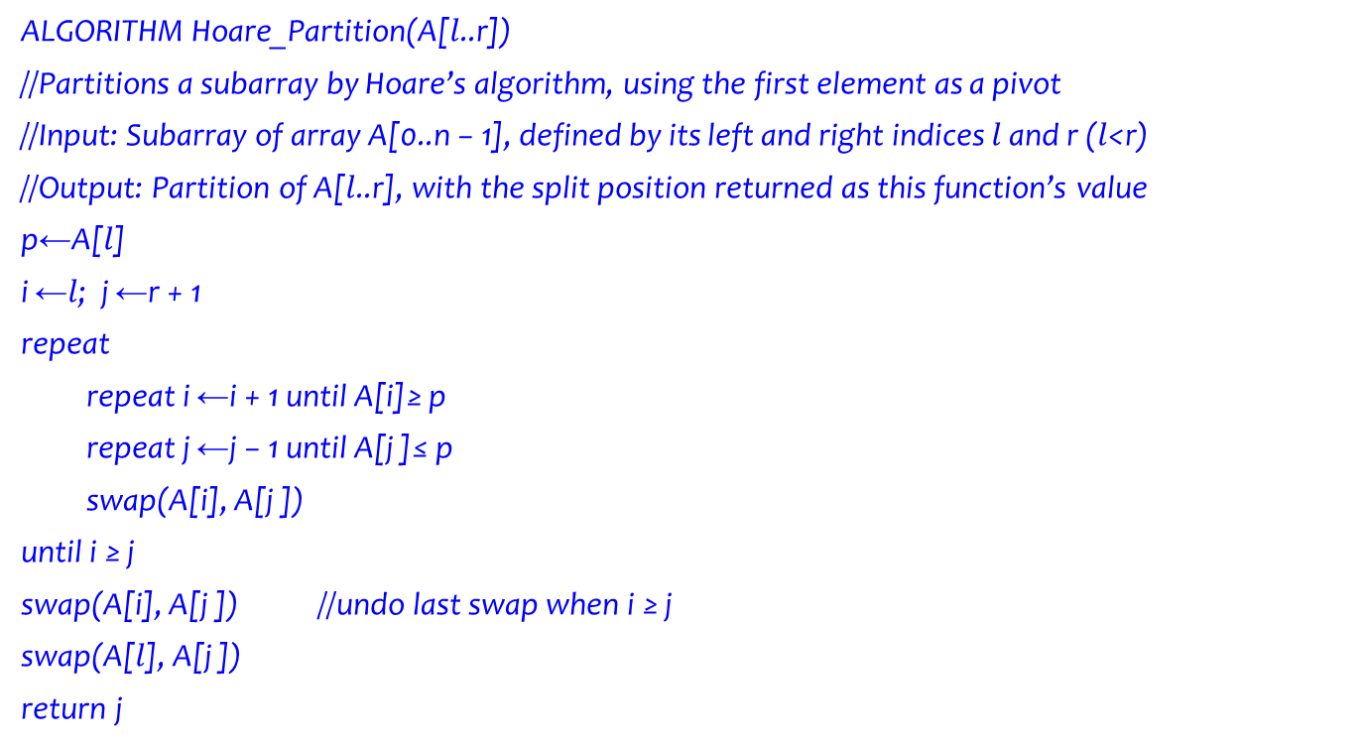
Sorting Algorithms
ALGORITHM Hoare_Partition(A[$l$..r])
//Partitions a subarray by Hoare’s algorithm, using the first element as a pivot
//Input: Subarray of array A[0..n − 1], defined by its left and right indices $l$ and r ($l$<r)
//Output: Partition of A[$l$..r], with the split position returned as this function’s value
p←A[$l$]
i ←$l$; j ←r + 1
repeat
repeat i ←i + 1 until A[i]≥ p
repeat j ←j − 1 until A[j ]≤ p
swap(A[i], A[j ])
until i ≥ j
swap(A[i], A[j ]) //undo last swap when i ≥ j
swap(A[$l$], A[j ])
return j
Pronounced Hawr

Slide 7
Sorting Algorithms

Slide 8

Sorting Algorithms
Analysis of QuickSort Algorithm:
General case: T(n) = T(n₁)+T(n-n₁) + Number of comparisons
Best case: T(n) = 2T(n/2) + $Θ$(n)
Worst Case T(n) = T(n-1) + T(1) + ?
Average case T(n) = T(s) + T(n-s-1) + ?

Slide 9
Sorting Algorithms
What if the input string is
or
the reverse
1 | 2 | 3 | 4 | 5 | 7 | 8 | 9
9 | 8 | 7 | 5 | 4 | 3 | 2 | 1

Slide 10
Sorting Algorithms
Q1: For the version of quicksort given in this section:
a. Are arrays made up of all equal elements the worst-case input, the best-case input, or neither?
b. Are strictly decreasing arrays the worst-case input, the best-case input, or neither?
Q2. a. Estimate how many times faster quicksort will sort an array of one million random numbers than insertion sort.
b. True or false: For every n > 1, there are n-element arrays that are sorted faster by insertion sort than by quicksort?

Slide 11
Sorting Algorithms
Comparison of algorithms for divide & conquer – MergeSort, Quick Sort, and Brute force algorithms – Insertion Sort, Selection Sort, Bubble Sort
Divide and Conquer – As the name implies divides the problem so that the fundamental solution structure can be applied recursively.
Incremental approach – We insert one element into its proper place.

Slide 12
Sorting Algorithms
Q: If Divide & Conquer algorithms are computationally efficient why attempt to use the not so clever or efficient Brute Force methods?
(i) Straight forward method;
(ii) Easiest to apply;
(iii) It is very difficult to point out problems it cannot tackle;
(iv) Can be developed for a wide variety of problems;
(v) The expense of designing a more efficient algorithm may not be justifiable if only a few instances of the problem need to be solved and the brute force algorithm can solve these instances with acceptable speed;
(vi) Useful for solving small to middle-size problems;
(vii) Hence, can be incorporated as part of Divide and Conquer to create a hybrid approach;
(viii) Serve as a yardstick to more efficient alternatives.

Slide 13
Sorting Algorithms
QUESTIONS?

